Slide 1
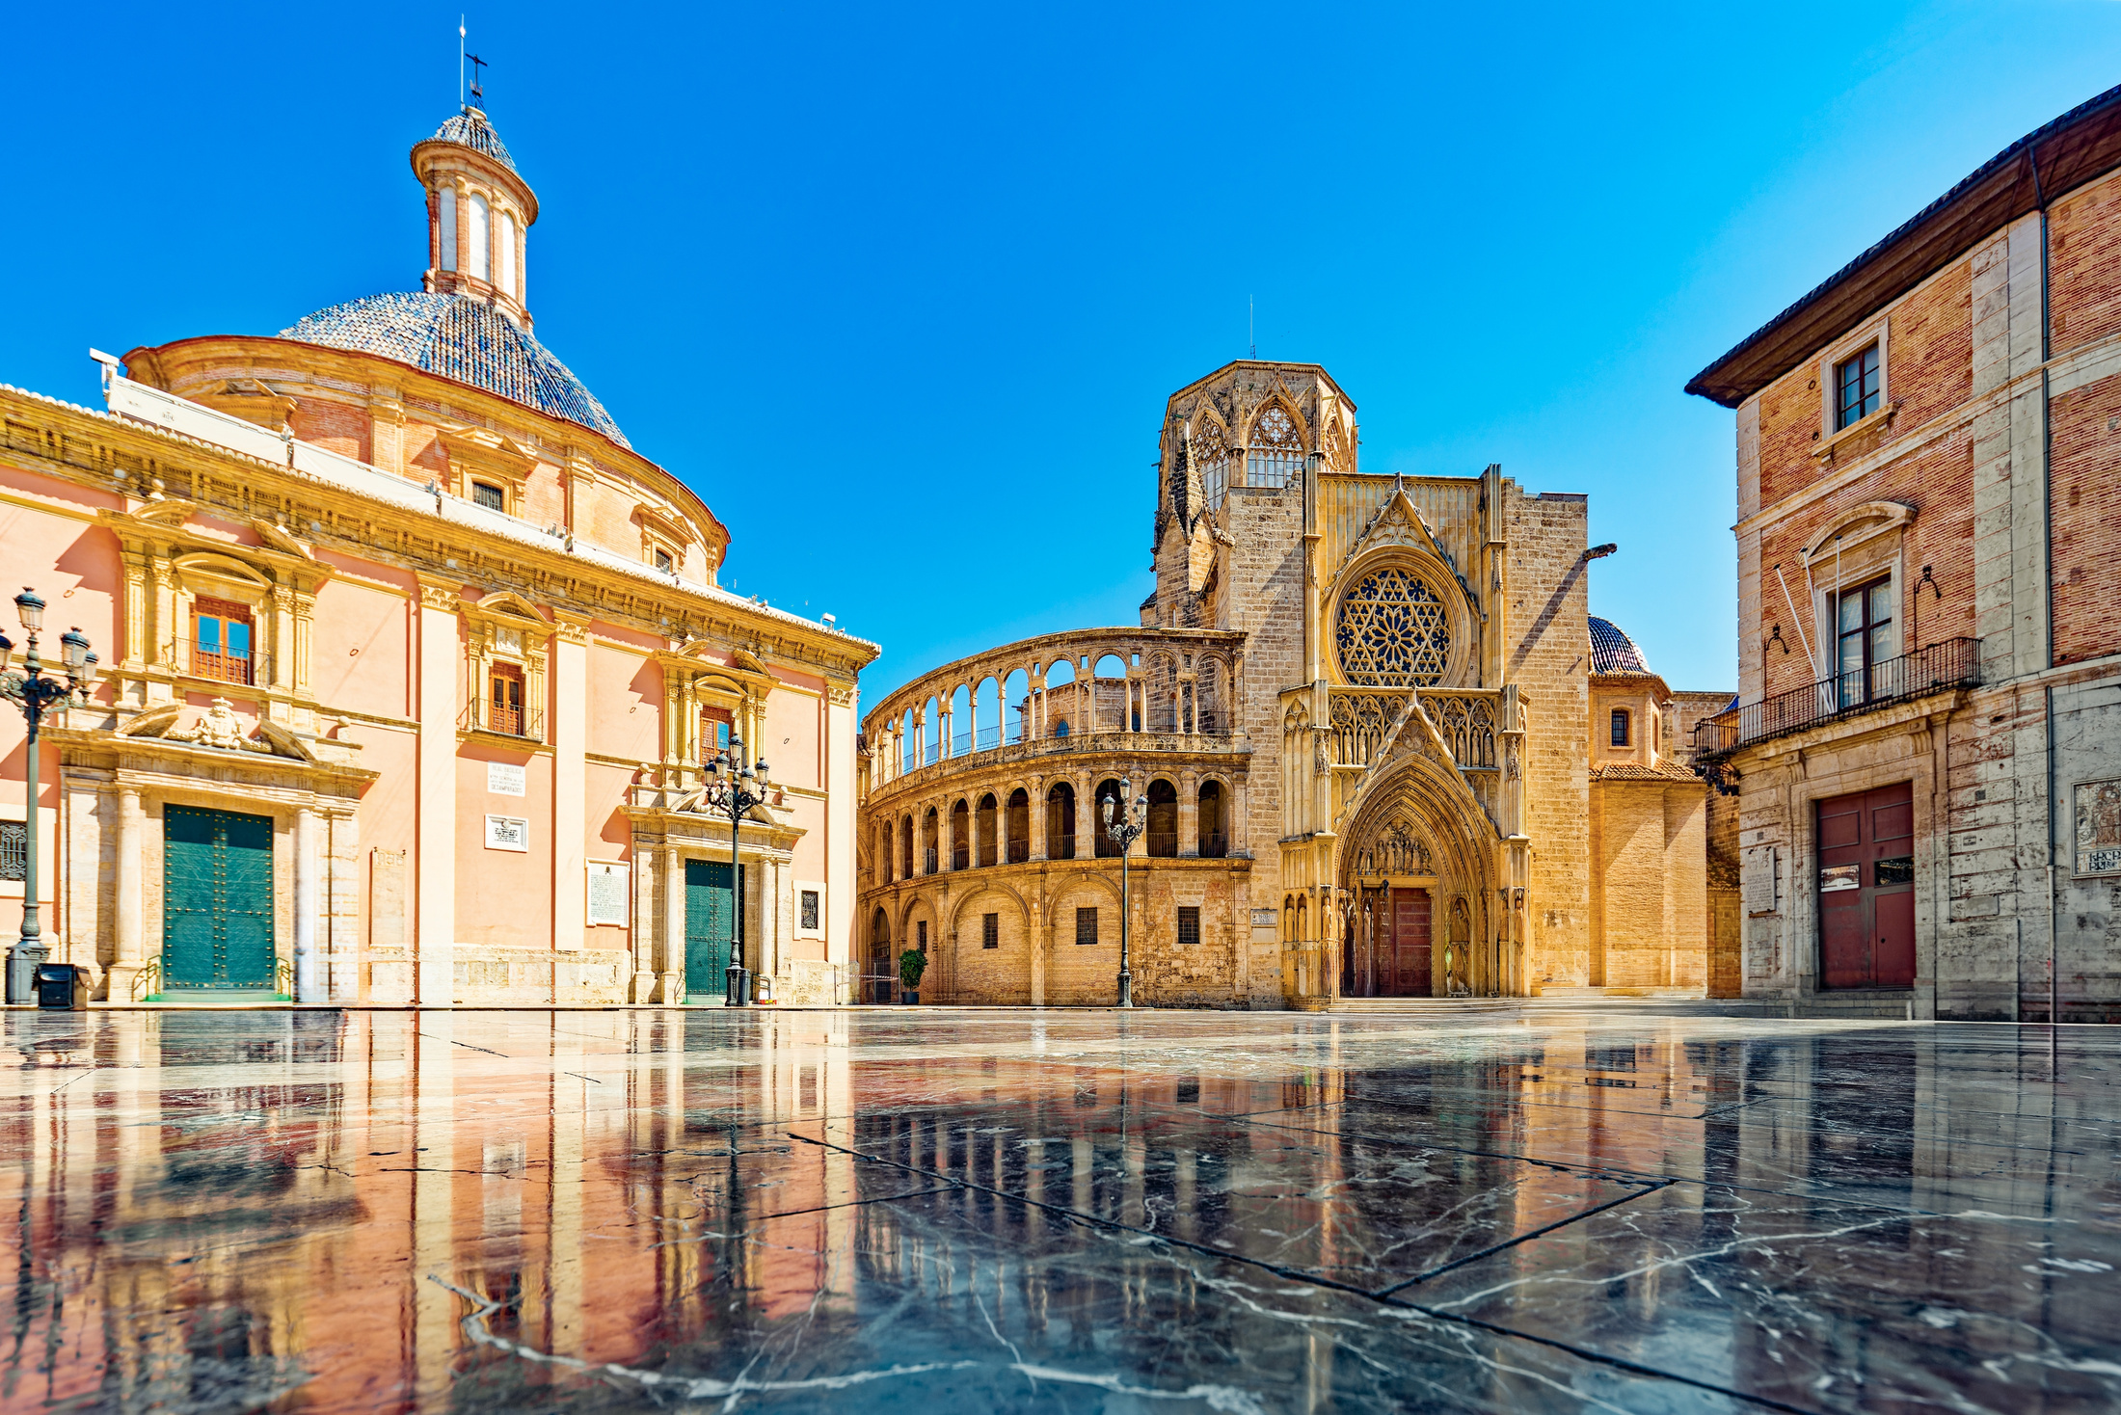

I’m attending SIOG 2026!
See you in Valencia.

Slide 2
I’m attending SIOG 2026!
Are you?

Slide 3

I’m going to
SIOG 2026 because
[enter reason]

Slide 4
Join me in Valencia as we move from vision to impact in Geriatric Oncology

Slide 5
I registered for
SIOG 2025 with the
Early Bird registration!
Don't miss your chance,
it ends on Sept 8!

