Slide 1

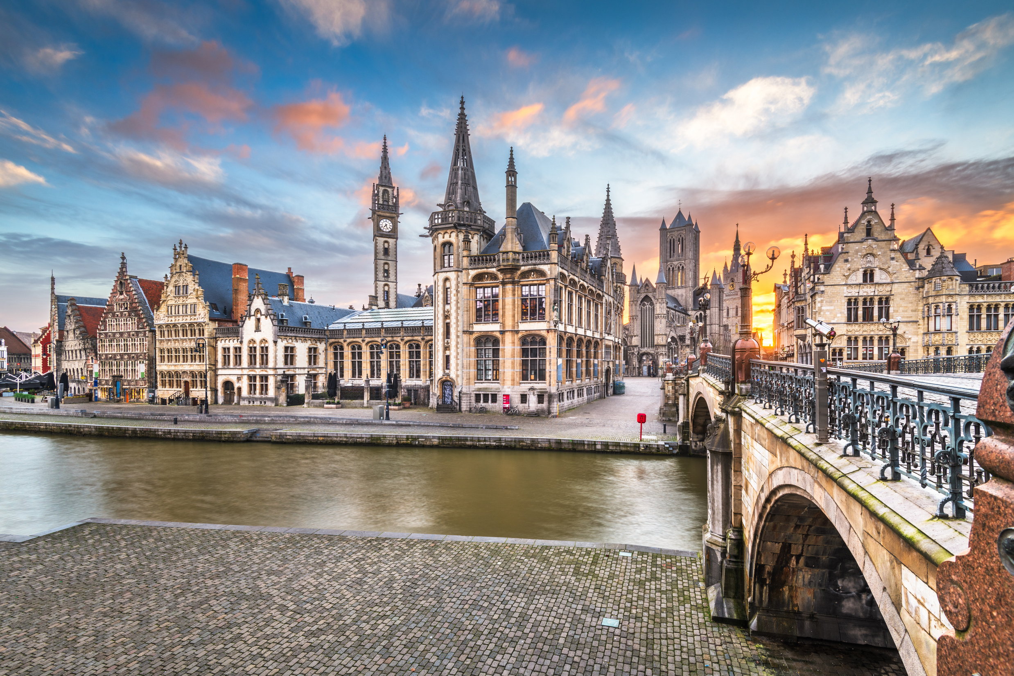
I’M ATTENDING
SIOG 2025!
Will I see you there?

Slide 2
I’M ATTENDING
SIOG 2025!
Are you?

Slide 3
I’M ATTENDING
SIOG 2025!
See you in Ghent

Slide 4
I’m going to
SIOG 2025 because
[enter reason]

Slide 5
Join me in Ghent to celebrate 25 years of SIOG!

Slide 6
I registered for
SIOG 2025 with the
Early Bird registration!
Don't miss your chance,
it ends on Sept 16!

