Slide 2
24th Conference of the International Society of Geriatric Oncology “Promoting Equity & Enhancing Optimal Care Delivery”
Check out the scientific programme
and register now!
www.siogconference.org
#SIOG2024
The full range of geriatric oncology covered in 5 tracks:
Track 1: Clinical trials and precision medicine in older adults with cancer
Track 2: Biology and epidemiology in cancer and aging
Track 3: Strategies and health services research to improve outcomes of diverse populations of older adults with cancer and their caregivers
Track 4: Supportive care delivery in older adults with cancer and their caregivers
Track 5: Education to improve geriatric oncology knowledge and practice

Slide 3
Pre-conference Workshops
Presidential Session
SIOG joint sessions with
CANO/ACIO
DIALOG
EORTC
Rising Tide/CARG
REGISTER NOW!
www.siogconference.org

Slide 4
SIOG 2024 Conference Awards
REGISTER
NOW!
siogconference.org
#SIOG2024
Presidential Session
Saturday, 19 Oct, 5:15 - 6:15 pm EST
Award presentation to finalists of the: SIOG Calabresi Award
SIOG National Representative of the Year Award
SIOG BJ Kennedy Best Poster Award
SIOG Nursing & Allied Health Investigator Award
SIOG Young Investigator Award
Arti Hurria Journal of Geriatric Oncology Annual Award

Slide 5
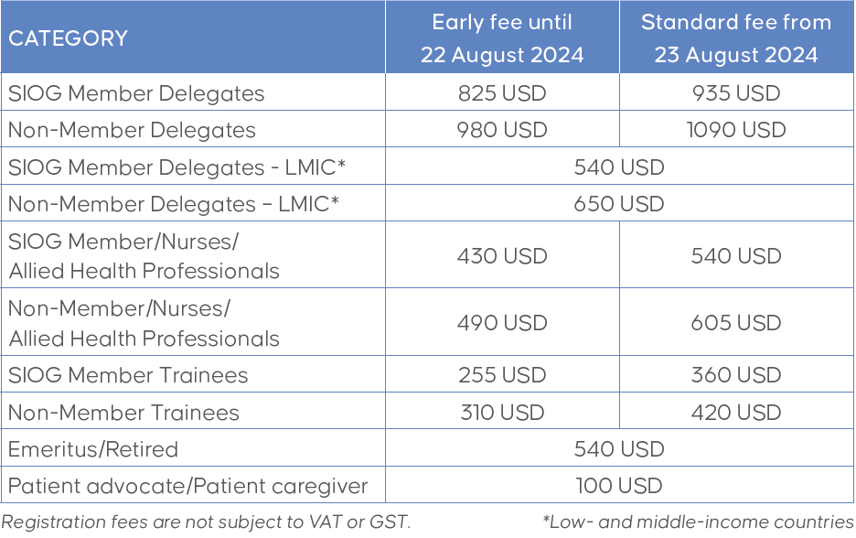
24th Conference of the International Society of Geriatric Oncology
“Promoting Equity & Enhancing Optimal Care Delivery”
REGISTER NOW!
www.siogconference.org

